Slide 1
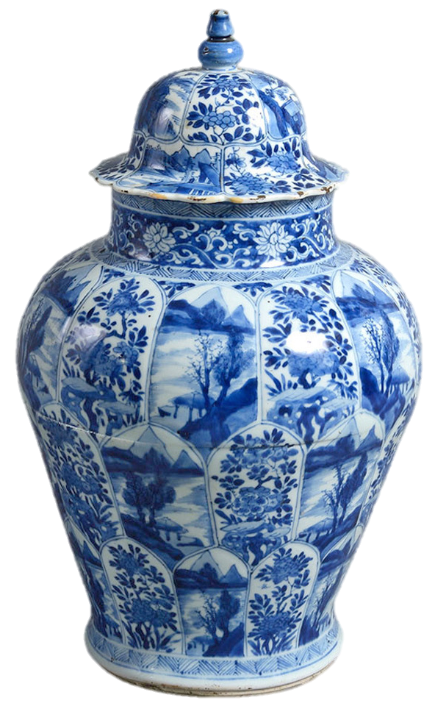
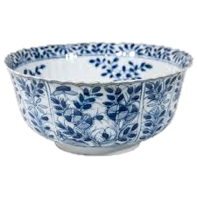
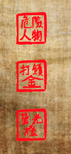
Exhibit 1
Wong’s Fine Porcelain
Don’t go Wrong, buy From Wong!
Our family has been making this beautiful pottery since the beginning of this century. The beautiful porcelain is made by combining clay with the rocks quartz and feldspar. We then bake it in a kiln, or oven, at very high temperatures. This makes the pottery white, sturdy and waterproof.
R
U
S
S
However, our porcelain is so fine that light can pass through it making it look delicate and beautiful. Now that we are in the 12th century, our family
has perfected blue and white porcelain making
so much so that it is available to the public in massive amounts. We have the best
craftspeople working for us, paining beautiful
blue pictures. We employ hundreds of
thousands of people to mass produce
dishes, bowls and vases. Europeans
have no idea to make this wonderful
porcelain and some think they won’t
be able to figure it out until the 1700s.
In the meantime, they will be buying
from us!
LIZ
Notes:
Exhibit 1 - Porcelain Advertisement
Font for title was downloaded from dafont.com
Chinese Asian Style

Slide 2
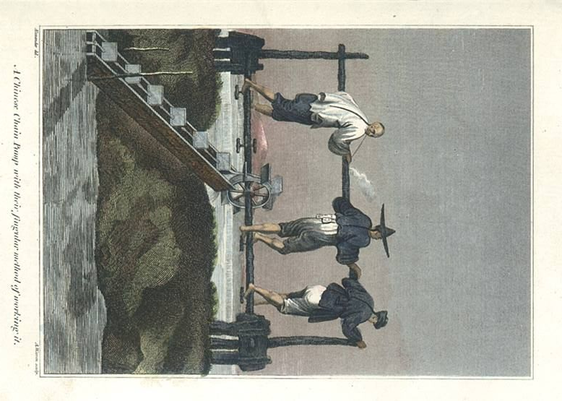
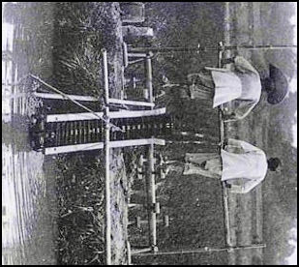
Source: http://trotto5agriculture2014.weebly.com/innovations.html
Exhibit 2
Source: https://www.emaze.com/@AFIQIWFZ/Dragon-Backbone-Pump
Exhibit 2
Notes:
Students have to use the picture to describe how it works.

Slide 3
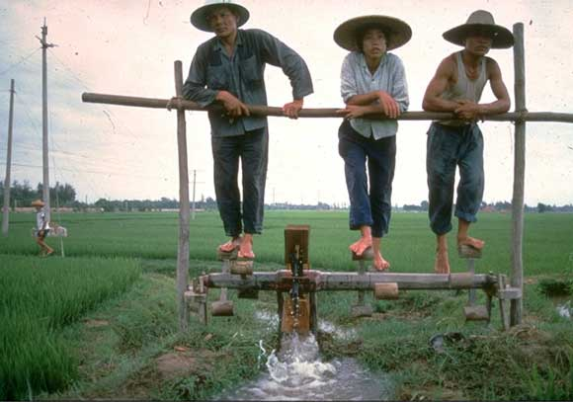
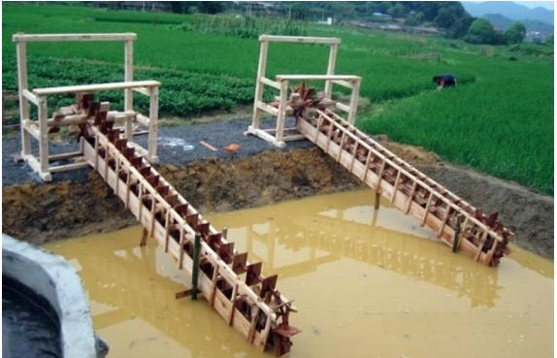
Exhibit 2
Source: http://www.kattler.dk/schiolers/uk/156.html
Exhibit 2
Source: http://www.kattler.dk/schiolers/uk/156.html

Slide 4
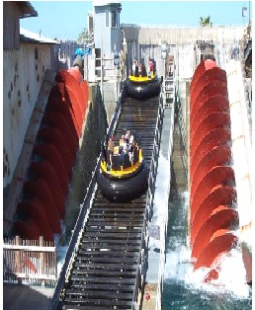
Exhibit 2
Dragon Backbone Pump
Under the Song Dynasty 960 AD – 1279 AD, the population grew to 100 million people. One of the reasons for this was the Dragon backbone pump. The dragon backbone was a water lifting device that pulled water from a canal into another, higher area – kind of like an escalator. The machine worked when people would pedal to make the wooden pump operate. With water available to new areas, farmers were able to grow even more food. The technique is still used today.

Slide 5
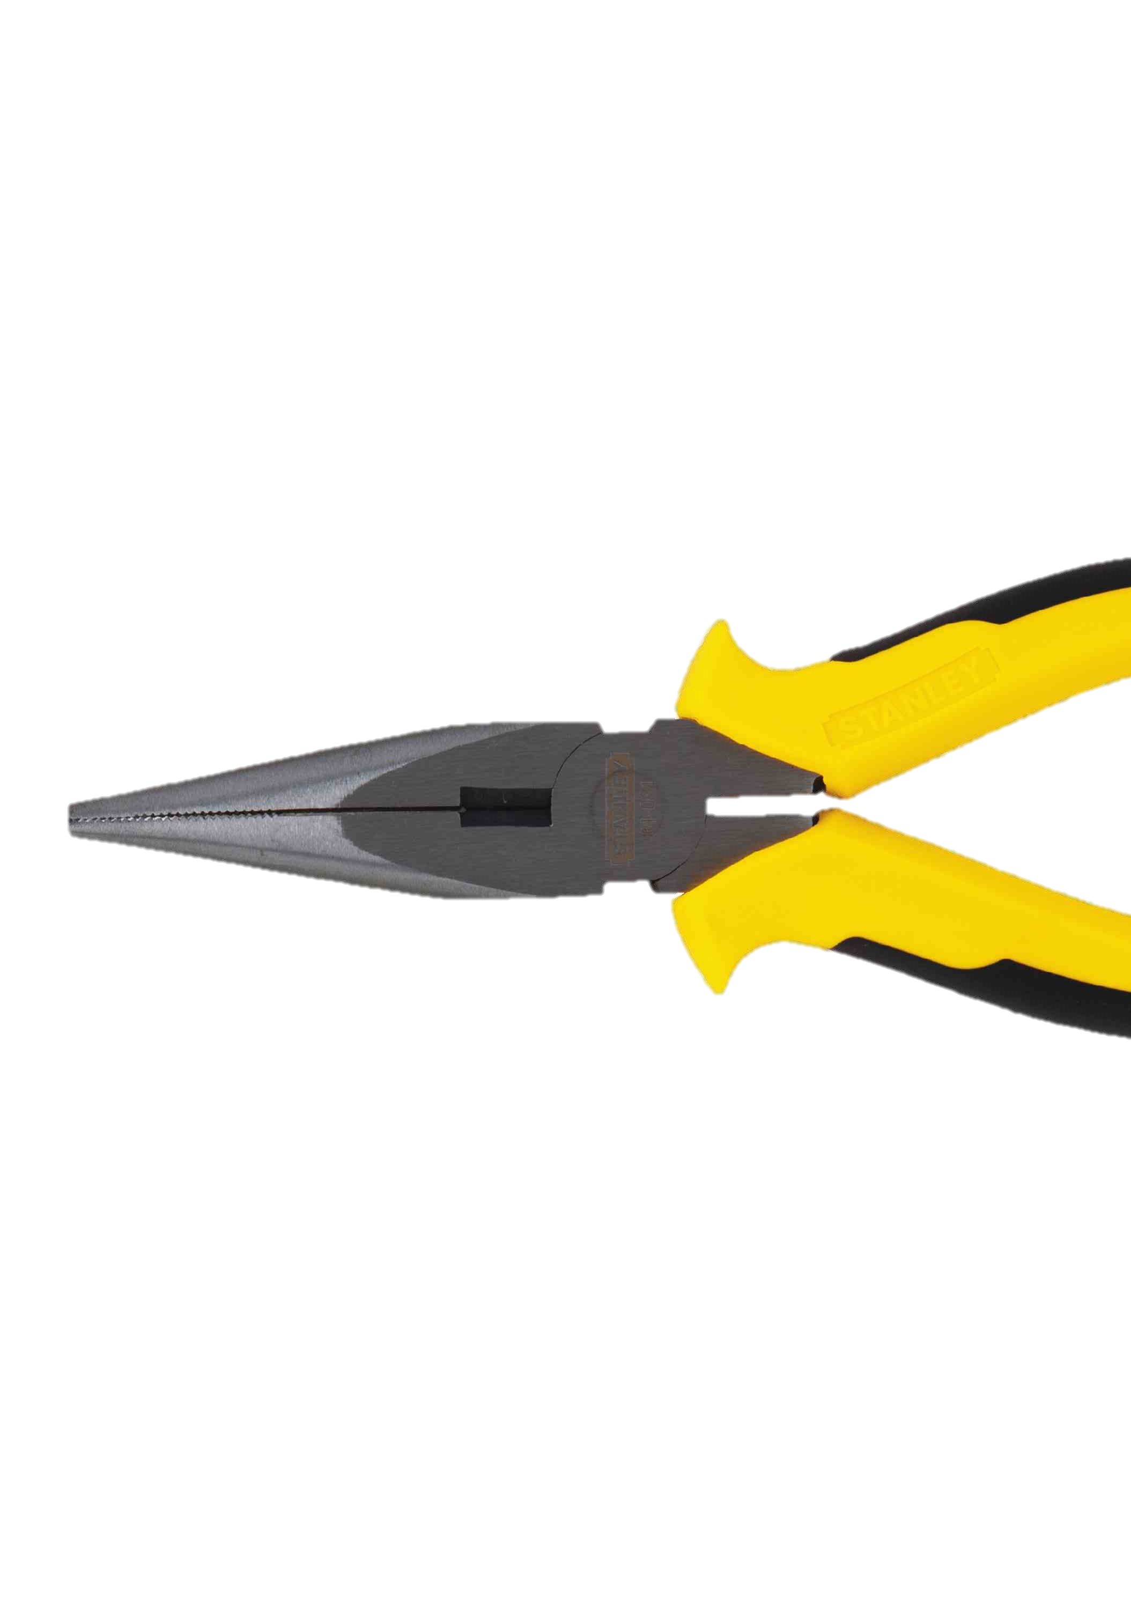
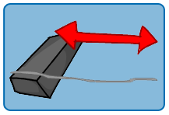
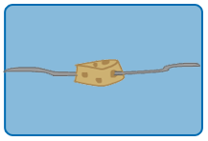
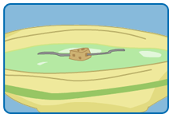
Exhibit 3
Chinese Wet Compass
What you’ll need:
What to do:
Straighten the paperclip. Try to get it as straight as possible, but be careful not to poke yourself!
Magnetize ½ of the paperclip by rubbing it against the magnet for about a minute. Make sure to use the same side of the magnet the whole time.
Poke the paper clip through the cork until the cork is on the center of your paperclip.
Float the paperclip/cork combo in the bowl of water and let it sit.
Now watch what happens. The paper clip should eventually point north/south. Try turning the bowl around to see if your compass will turn back to the north again.
What happened?
The earth produces a magnetic field. It's not strong enough to make refrigerators start flying around, but it is enough to align lighter magnetic objects with it. By floating the magnetized paperclip in the water you freed it up from other forces so that it could be pulled around by the earth's magnetic field.
Adapted from: http://www.chabad.org/kids/whatif/default_cdo/aid/951799/jewish/Experiment.htm
Notes:
Compass Hands On Lab

Slide 6
Exhibit 4
Chinese Wet Compass
One of the first recordings of using a compass for navigation was during the Song Dynasty from 960 – 1279 AD. These compasses were made by floating a magnetized needle in water. The needle could move freely in the water and point to the earth’s magnetic poles no matter the movement from the ship.
Considered to have one of the greatest impacts on human civilization, the compass changed the ability to trade via sea. Trading ships were now able to safely sail as far as Arabia without getting lost. China traveled farther and faster than others.
Below: The bronze compass with the magnetized spoon was used on land, mostly for fortune telling and Feng Shui, arranging buildings and furniture according to the forces of nature.
Adapted from: http://www.learnchinesehistory.com/history-chinese-compass/
Notes:
Gunpowder

Slide 7
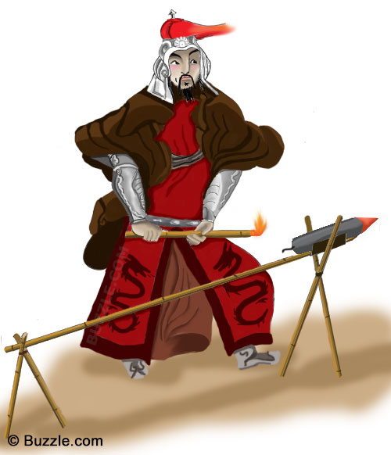
Exhibit 5
Chinese Gunpowder
Source: https://www.youtube.com/watch?v=YpZnq8Iye1E
Notes:
https://www.youtube.com/watch?v=YpZnq8Iye1E
New Video Evidence

Slide 8
Exhibit 4
Chinese Gunpowder
Around 850 AD, Chinese alchemists were trying to create potions to help people live longer. Instead, they discovered gunpowder.
By the twelve hundreds, gunpowder was used in weapons such as fire arrows, bombs, and fire lances.
China used gunpowder against the Mongols who were invading from the North. They would attach a tube of gunpowder to an arrow and launch the arrows across enemy lines.
Gunpowder was traded along the Silk Road to Europe and Arabia. By thirteen fifty, Arabs made gunpowder cannons.
Handguns appeared in the four teen fifties.
Notes:
https://www.youtube.com/watch?v=h_wGAa7FXqE&rel=0&utm_source=Transactional&utm_medium=Email&utm_campaign=Transactional-Publish-success

Slide 9
Exhibit 6
Lesson 6
Chinese Advancements in Printing
Among the most significant innovations of the Tang (618–906) and Song (960–1279) dynasties were the inventions of woodblock printing and moveable type, which allowed for widespread publishing of a variety of texts, and the spreading of knowledge and literacy.
Chinese Woodblock Print
Woodblock Print
Scholars believe that woodblock printing first appeared in China around 600 AD. The process for block printing on paper was perfected by the end of Tang dynasty.
Wood for printing blocks usually came from date or pear trees. The text that people wanted printed was first written on a sheet of paper. The paper was then glued face-down to the wood block and, using a knife, the characters on the paper were carefully engraved on the wood.
After the woodblock was made, the printer put ink on top of the wood block and then carefully pressed paper onto the wood block.
At first, woodblock printing was mainly used for printing books on agriculture and medicine,
Part of woodblock printing work "Dwelling in the Fuchun Mountains"
as well as for printing calendars, calligraphy, and auspicious charms. In 762, the first commercially printed books were sold in the markets of Chang’an, the Tang capital. In 782, printed papers were available in the marketplace as receipts for business transactions and tax payments.
Although woodblock printing played an important role in the spread of information in China, it was a time-consuming technology. For example, in 971, at the beginning of Song dynasty, the monk Zhang Tuxin began a project to print Buddha scriptures using wood blocks. It took him twelve years to finish printing the 1076 volumes. The limitations of woodblock printing led to the invention of moveable-type printing during the Song dynasty.
Today, people still practice the art of woodblock printing.
Source: http://education.asianart.org/explore-resources/background-information/invention-woodblock-printing-tang-618%E2%80%93906-and-song-960%E2%80%931279

Slide 10
Exhibit 7
Hello,
I’m paper.
Look…you might be going around and learning all about other inventions but let’s be real. I’m the most important invention that you have learned about so far. Yes – moveable type is important and sure, gunpowder is great. But without paper, none of these ideas would have spread to other countries or lasted for this long.
A lot of you take me for granted because I’m inexpensive and it’s easy to get a hold me. But I’ve come a long way from when I was created to the form you know today. People don’t appreciate me but I have revolutionized a lot of things like civilizations, culture, and education. Let me explain.
The earliest form of paper was made around 100 AD in China. It was made by chopping bark, hemp, and fish nets. Then, they would mix it with water, mash it flat, and let it dry in the sun. It worked pretty well.
In 740 AD, after woodblock print was finally invented, newspapers were finally found in China. All thanks to me!! The Chinese finally had a reason to learn to read since texts were avvailable. Also, ideas and knowledge were exchanged on paper.
Soon, Korea and Japan learned the art of paper making from monks who visited China. They started making paper as well. China really tried to keep the art a secret but the knowledge soon spread along the Silk Road trade route.
During the Tang Dynasty, China fought with the Arab Ottoman Empire and the Arabs captured Tang paper makers to set up a paper making factory in Baghdad in 793 AD. The Arabs tried to keep it a secret, too, but it spread to Egypt in the 900s, all over North Africa by 1100s, and ultimately reached Spain by 1150. Paper making had finally reached Europe!
So there you have it. My story. If it wasn’t for me, ideas, books, beliefs, and news would not be available to people. The only people who might have the information would be the rich people. Because of me, information was available to more and more people.
You could live without a compass. You can live without gunpowder. But with books and knowledge, there is no meaning.
Love,
Paper

Slide 11
Exhibit 8
China’s Paddlewheel Boat
Source: http://www.cogandgalley.com/2009/10/chinese-paddle-wheel-ships.html
#travelbringsideas #travelbetter #travelcheaper

Slide 12
Exhibit 8
China’s Paddlewheel Boat
Source: http://www.paddleducks.co.uk
/smf/index.php?topic=2873.0
@Bestinvention The paddlewheel boat is the greatest invention because people could finally control the ships without winds or oars which helped people control the seas to better travel, trade, and battle.

Slide 13
Exhibit 8
China’s Paddlewheel Boat
Source: http://historum.com/asian-history/46029-east-asian-ships-pictures.html
Paddleboat travel was much faster than canoe or small boat.
Rulers of the Song Dynasty (960-1279 AD) built entire fleets of paddleboats for their navies, especially for sneak attacks.
Some boats included as many as eleven paddle-wheels on each side for greater speed and maneuverability.

Slide 14
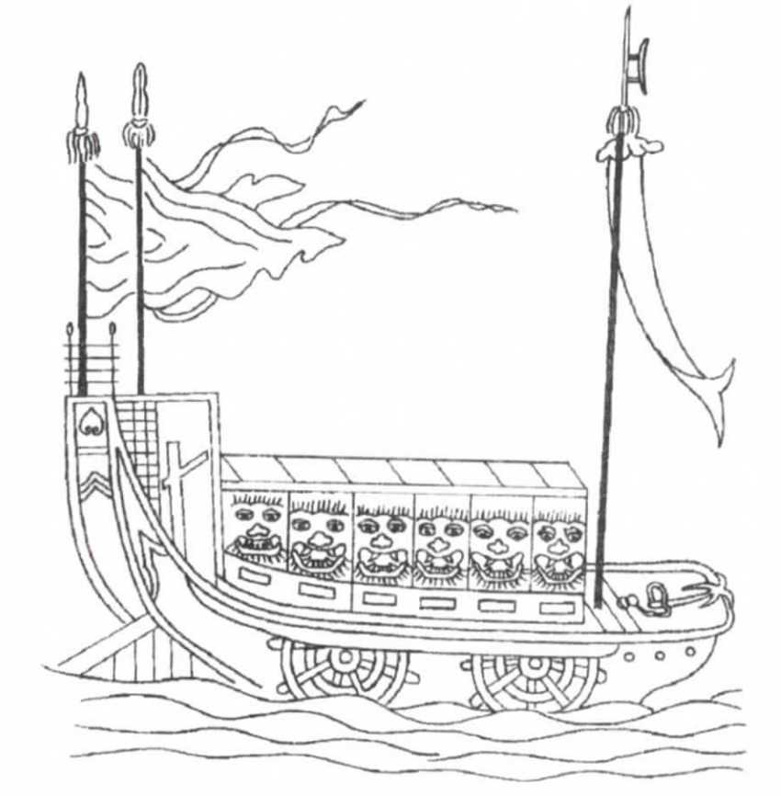
Exhibit 8
China’s Paddlewheel Boat
Source: https://en.wikipedia.org/wiki/Paddle_steamer
First appeared in 700s
Paddleboats were used to travel on rivers without depending on wind.
Paddleboats were powered by humans and were used to travel on rivers and across lakes.

Slide 15
Exhibit 9
How Does a Canal Lock Work?
Source: http://www.slideshare.net/JimGarner17/the-panama-canal-presentation
Source: http://www.slideshare.net/JimGarner17/the-panama-canal-presentation
Exhibit 9
Notes:
Image #1 http://www.slideshare.net/JimGarner17/the-panama-canal-presentation
Image #2 https://www.sawater.com.au/community-and-environment/the-river-murray/lockages

Slide 16
Exhibit 9
How Does a Canal Lock Work?
Source: http://www.pitara.com/science-for-kids/5ws-and-h/what-are-canal-locks/
Exhibit 9
How Does a Canal Lock Work?

Slide 17
Exhibit 9
Canal Lock: Greatest Invention?
“Canal locks are the greatest invention because they allowed boats to travel from a one body of water to another, even if they were at different levels in height. Trade became much quicker and less costly once canal locks were invented. If canal locks hadn’t been invented, shippers would have had to unload boats when they came to a body of water that was at a higher level. They would have had to load the cargo onto an animal and walk the animals to the next body of water. Then they would load up the boats. All of this took time and money.
Canal locks eliminated the need for all of this additional work and cut shipping costs by 90%.”
-R.S. Nielsen

Slide 18
Exhibit 10
Ministry of Agriculture
Of The People’s Republic of China
Citizens of China,
I am proud to serve as the leader over China’s rich agricultural resources. China has a long history of farming and cultivation and our government has always placed high priority to the work on farms and new and improved farming techniques.
One such improvement, that was arguably China’s greatest invention, took place in the early part of the Song dynasty. A new variety of fast ripening rice was discovered. The rice was more drought resistant and could be grown in the higher altitudes of our mountains. This rice ripened so quickly that farmers could grow double the amount of rice, sometimes even triple! The rice was so strong and hardy that it made an even bigger population possible. There was so much rice that China experienced widespread food surpluses. During the Song Dynasty, the population doubled, making China the most populated civilization on earth at the time. This was all due to the labor of our farmers and the science involved in create a rice that grew faster and easier.
As we move into the future, we energetically dedicate greater investments into agriculture, farming science and farming technology. The Chinese nation prides itself on having created a great civilization of agriculture and will continue to be leaders of the agrarian world.
Mr. Han Changfu
Minister of Agriculture
Ministry of Agriculture, PRC Site ID: ICP (BJ) No.05039419

